Slide 1
Rapid Overview of Areas of Return (ROAR) Hatra
Returns Working Group
17 October 2019

Slide 2
Objectives and Methodology
General Objective
A collaboration between REACH Initiative and the Returns Working Group (RWG), the aim of the assessment is to inform the recovery process in order to support durable and safe returns to the area.
The ROAR assessment looks at the motivations behind return, along with the current context related to protection issues, livelihoods, and the provision of basic services in areas of Iraq that are experiencing returns.
Methodology
Data for Hatra was collected between 9 and 20 June.
57 remote Key Informant Interviews (KIIs) with community leaders, returnees, re-displaced persons, IDPs, and subject-matter experts (SMEs).
Findings, including population estimates, are indicative only.
Notes:
In the case of Hatra, many internally displaced persons (IDPs) had not returned, and a significant proportion of returnees had reportedly re-displaced.
For this reason, REACH decided to include additional questions in this round of assessment, for those who had re-displaced after returning to their area of origin (AoO).

Slide 3
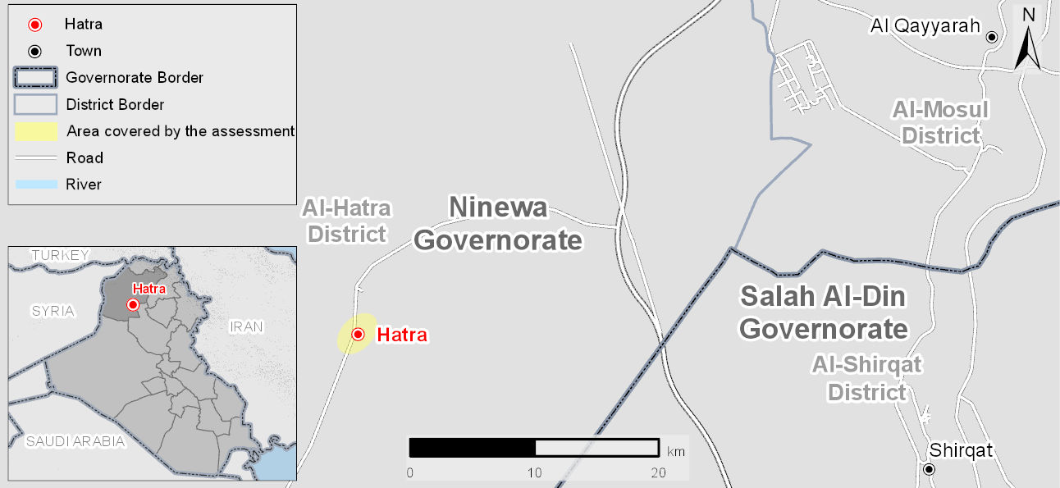
Area of Assessment
Notes:
Hatra is located 115 kilometres south of Mosul, and 80 kilometres west of Al Qayyarah,
Hatra town is the southernmost populated area in Ninewa governorate, bordered by the desert commonly known as al-Jazeera

Slide 4
Background and Context
Background
Hatra district and town were taken by ISIL in June 2014. After military offensives, the Government of Iraq (GoI) re-established control in the area in April 2017.
The town experiences ongoing insecurity due to asymmetric attacks, as well as reports of the continued presence of ISIL cells. Consequently, it has been largely isolated from humanitarian assistance and reconstruction efforts, with limited information available about the needs of those that live there.
Population dynamics
Predominantly Sunni Arab population.
Community leader KIs estimated the population to be around 2,000 families prior to the arrival of ISIL
During ISIL control and the following military operations from GoI, the majority of families were reportedly displaced from Hatra town.
The majority of the population was reported to still be in displacement. Community leader KIs estimated that between 200 and 300 families had returned.
Notes:
2,000 = approximately 9,000 individuals.
Information regarding their decision to remain was conflicting, since one KI reported that those families did not have the financial means to displace when ISIL arrived, and another reported the remainees had affiliation with ISIL.
Four KIs reported that there were some remainees in Hatra when ISIL arrived (400 families approximately ) who had since displaced and were not being allowed to return.
As indicated by IOM DTM figures, by the 30 June 2019, an estimated 274 internally displaced (IDP) families had returned to Hatra town.

Slide 5
Displacement and Return
Why have people returned?
Approximately 10% of the total number of households living in Hatra prior to the arrival of ISIL had returned, based on community leader KI estimates; most of the households had returned between 2017 and 2018.
When asked about what influenced their decision to return, over half of the returnee and re-displaced KIs reported that they had returned to claim their property (10 out of 18 KIs).
Number of KI returnees by reason for returning to Hatra (out of 18 KIs)
Notes:
18 includes returnee KIs and re-displaced KIs.
All returnee KIs reported needing both security clearance from security forces to return, as well as a letter from their community leader.

Slide 6
Displacement and Return
Why have people not returned?
The most frequently reported reason for IDPs not returning was poor access to services, especially to water services, (10 out of 10 IDP KIs) and better access to services in their AoD (6 out of 10 IDP KIs).
Why have people re-displaced?
Community leader KIs reported that additional numbers had returned but since re-displaced; the number of re-displaced families was estimated to be around 30 (approximately 10% of reported returnees).
The most frequent reported reasons for re-displacement were:
Insufficient or no access to basic services (20 out of 24 KIs), with 10 citing the lack of drinkable water specifically.
Lack of job opportunities (14 out of 24 KIs).
Humanitarian assistance available in AoD (mostly camps) (6 out of 24 KIs).
Property being damaged and/or looted (4 out of 24 KIs).
Lack of other returnees (2 out of 24 KIs).
Neither IDPs nor re-displaced KIs expressed an intention to return to their area of origin (AoO) in the 12 months following the assessment.
Notes:
The majority of the Hatra population that had displaced had reportedly not returned
21 out of 24 KIs reported that persons with perceived ISIL affiliation were not allowed to return. The 24 KIs included re-displaced, IDPs, returnees and community leaders answering why there were families that had re-displaced.

Slide 7
Protection
Perception of safety
All returnee and community leader KIs reported feeling safe inside the town due to the presence of security forces (21 KIs).
However, KIs reported not feeling safe outside of Hatra town; two KIs reported that the volatile security situation outside of the town had resulted in the death of some residents who had traveled outside of Hatra.
15 KIs specified surrounding villages and the desert strip between Hatra and the Syrian border, known as Al-Jazeera, to be of particular concern, due to reports of ISIL activity.
Freedom of movement
There were no reports of curfews and or restrictions of movement inside the town by security forces.
According to KIs, residents did need security clearance from community leaders and security forces to travel to places such as Al Qayyarah.
Civil Documentation
The court in Hatra was reportedly not functioning. To access legal services, residents had to travel to Al Qayyarrah. Barriers to access therefore related to cost of travel and need for security clearance
Notes:
All KIs include returnees, community leaders and protection experts

Slide 8
Protection: HLP
Housing, Land, and Property (HLP)
Most of the governmental institutes had been severely damaged. One community leader also indicated that there had been damage done to private property during and after ISIL’s presence in the town.
Many of the families were reportedly sharing a living space between two families, in part because of widespread looting of property during ISIL.
There had not yet been any compensation for lost property by the government reported. In order to receive compensation, KIs reported having to go to Al Qayyarah court.
A number of KIs reported that the lack of government compensation for lost or damaged property was a reason that IDPs from Hatra remained in displacement.
KI Recommendations:
Restore the court in Hatra to alleviate reliance on the court in Al Qayyarah.
Notes:
Damage:
During ISIL’s control of the town around 40 houses from families related to members of the security forces had been destroyed
According to one KI, further destruction to private property had been done after Iraqi security forces took control of the town; 15 to 20 houses belonging to families with perceived affiliation with ISIL were also destroyed.
21 KIs include returnees, community leaders, and legal experts.

Slide 9
Livelihoods
KI reports on the number of households not receiving income varied notably, the most common answer being between 20 and 30 families (9 out of 21 KIs); less than 10% of the estimated total number of households living in Hatra town.
The number of households without income was said to be relatively low because almost half of returnee households were receiving government salaries; the remaining households depended on daily work and livestock.
Only people with government salaries were reportedly able to meet their basic needs with their wages.
There was an estimated increase in use of coping strategies, with many families:
Having to rely on their relatives or neighbour’s assistance (14 out of 21 KIs). It was further explained that this was often sent from relatives who received humanitarian assistance in the camps.
Taking on debt (7 out of 21),
Re-displacement (6 out of 21 KIs)
Cutting daily costs for household basic-needs (3 out of 21),

Slide 10
Livelihoods
The availability of livelihoods opportunities across all professions was reported to have decreased compared to pre-ISIL, especially agriculture (11 out of 21 KIs); followed by shepherding and livestock (7 out of 21)
The town was said to have been strongly reliant on shepherding and agriculture prior to ISIL’s control of the town.
Lack of livelihoods opportunities was perceived to be closely tied to the limited number of returns, and vice versa.
KI Recommendations:
Giving compensation for returnees
Providing support for farmers
Providing cash and food support by the government such as PDS, or from NGOs
Creating new employment opportunities
Providing business grants
Rehabilitation of public and private buildings
Notes:
The reported reasons for a decrease in agriculture were: fear of ISIL attacks (11 out of 21 KIs), lack of support from the government (eight out of 21 KIs), farmers still being in displacement (six out of 21 KIs), several years of lack of rains and sulphuric water from the wells (six out of 21 KIs), high prices of seeds, lack of farming equipment and fertilisers (four out of 21 KIs), and rising salinity of the soil (two out of 21 KIs).

Slide 11
Basic Services: Health
Service | Key Findings
Health expert KIs | One damaged but functional public clinic and one healthcare point (mainly assisting security forces). Reported shortage of medical staff: only 4 in the public clinic, and no female doctors, nor private doctors or surgeons. Lack of equipment due to looting. No functional pharmacies; medicines in short supply. Residents had to travel for emergency or specialist treatment to al Qayyarah or Mosul. The most urgent healthcare needs were reported to be maternity services (17 KIs out of 21) and surgery (15 KIs out of 21).
KI Recommendations:
Health SME KIs suggested repair of the healthcare clinic, and additional doctors and equipment.
Notes:
One KI noted that before the arrival of ISIL, there had been 36 medical staff.

Slide 12
Basic Services: Education
Service | Key Findings
Education expert KIs | There reportedly were 1 primary school (mixed), 1 middle school, and an accelerated learning school. Before ISILs presence, there had been 6 school facilities operational The primary school was reportedly overcrowded and there was a lack of teachers High school students had to travel to al Qayyarah 15 out of 21 KIs indicated that there were not enough school supplies, mainly books, desks, teaching materials, and blackboards. In the 12 months prior to data collection, KIs confirmed that schools had been repaired by the Ministry of Education.
KI Recommendations:
Education SME KIs reported a need for more teachers and school supplies.
Notes:
One returnee noted that before the arrival of ISIL, there had been 36 medical staff.
The accelerated learning school was functioning inside the primary school facility.

Slide 13
Basic Services: Water and Electricity
Service | Key Findings
Water expert KIs | The water treatment plant (WTP) in Hatra was reportedly not functioning Currently depended on the WTP from Shirqat, but quality was low and availability scarce (but varied across neighbourhoods). Water services were the most important need in Hatra, according to community leader KIs.
Electricity expert KIs | All households in Hatra had access to public grid every day for roughly 24 hours. This was mainly due to the low number of families in Hatra. KIs reported there were no community generators; the public network was sufficient given the low population widely spread out across the town.
KI Recommendations:
Water SME KIs suggested to improve water services by providing more generators and equipment for the Hatra WTP and repairing pipes
Electricity SMEs suggested that to improve electricity services, which would be necessary if returns were to increase, they needed more transformers and community generators
Notes:
Nine out of 22 KIs reported that people were getting ill from the water
The majority of residents receiving water for only a few hours once every 10 to 15 days, although reported amounts did vary. The difference in responses was largely due to the irregularity of piped water availability over time and across different neighbourhoods. Certain neighbourhoods had no access at all to piped water, such as: Al-Madares due to insufficient water pressure and old pipes, or Al-Hawasem where new houses had been built and not yet connected to the infrastructure
Reporting of water as a priority need which corresponds with the reports of IDPs and re-displaced KIs (four KIs) that saw water as a major obstacle to return.
Waste:
The municipality was reportedly responsible for the waste collection without any cost. Waste was collected from the houses twice a week in each neighbourhood
Experts suggested that to improve waste removal services they needed financial support, to hire more workers, and increase the number of trucks and containers.

Slide 14
Reported Assistance Received
Actors reported to be providing assistance:
The Ministry of Education had repaired the schools’ facilities.
A local NGO had done some repairs to the public health clinic.
United Nations Development Program (UNDP) was undertaking repairs to the public clinic at the time of data collection.
The Directorate of Water and an international NGO (name unknown) were undertaking repairs to the water treatment plant (WTP) at the time of data collection.
A local NGO (name unknown) ran a mobile health unit to assist the surrounding villages.
Notes:
Despite the perceived isolation of the town, governmental and humanitarian actors — both local and international — providing assistance.
Legal: Documentation not really reported as an issue. Movement only reported as an issue in areas where ISIL presence. There is an increased cost of accessing legal services.

Slide 15
REACH Initiative
Available upon request
Available upon request
Available upon request
http://www.reachresourcecentre.info/
IMPACT Initiatives
@REACH_info

